Slide 1
Chapter 5: CPU Scheduling

Slide 2
Basic Concepts
Maximum CPU utilization obtained with multiprogramming
CPU scheduling is a fundamental operating system function
CPU–I/O Burst Cycle – Process execution consists of a cycle of CPU execution and I/O wait
CPU burst is followed by I/O Burst in alternating sequence
  An I/O-bound program has many very short CPU bursts
  A CPU-bound program might have a few long CPU bursts

Slide 3

Alternating Sequence of CPU And I/O Bursts

Slide 4
CPU Scheduler
Selects from among the processes in memory that are ready to execute, and allocates the CPU to one of them
CPU scheduling decisions may take place when a process:
  1. Switches from running to waiting state
  2. Switches from running to ready state
  3. Switches from waiting to ready
  4. Terminates
Scheduling under 1 and 4 is nonpreemptive
All other scheduling is preemptive

Slide 5
Dispatcher
Dispatcher module gives control of the CPU to the process selected by the short-term scheduler; this involves:
  switching context
  switching to user mode
  jumping to the proper location in the user program to restart that program
Dispatch latency – time it takes for the dispatcher to stop one process and start another running

Slide 6
Scheduling Criteria
CPU utilization – keep the CPU as busy as possible
Throughput – # of processes that complete their execution per time unit
Turnaround time – amount of time to execute a particular process
Waiting time – amount of time a process has been waiting in the ready queue
Response time – amount of time it takes from when a request was submitted until the first response is produced, not output (for time-sharing environment)

Slide 7
Scheduling Algorithm Optimization Criteria
Max CPU utilization
Max throughput
Min turnaround time
Min waiting time
Min response time

Slide 8
First-Come, First-Served (FCFS) Scheduling
the process that requests CPU first is allocated the CPU first
  For example:
Process Burst Time
P₁ 24
P₂ 3
P₃ 3
Suppose that at time 0, the processes arrive in the order: P₁ , P₂ , P₃ .The Gantt Chart for the schedule is:
  Waiting time for P₁ = 0; P₂ = 24; P₃ = 27
  Average waiting time = (0 + 24 + 27)/3 = 17
  Average turnaround time = (24+27+30)/3 = 27
P₁
P₂
P₃
0
24
27
30

Slide 9
FCFS Scheduling (Cont.)
Suppose that at time 0, the processes arrive in the order
P₂ , P₃ , P₁
The Gantt chart for the schedule is:
Waiting time for P₁ = 6; P₂ = 0; P₃ = 3
Average waiting time: (6 + 0 + 3)/3 = 3
Average turnaround time = (30+3+6)/3 = 13
Much better than the previous case, in which process arrived in the order of P₁ , P₂ , P₃ .
Convoy effect: short processes behind a long process
P₂
P₃
P₁
0
3
6
30

Slide 10
Shortest-Job-First (SJR) Scheduling
Associate with each process the length of its next CPU burst. Use these lengths to schedule the process with the shortest time
  More appropriate term would be the shortest next CPU burst first
Two schemes:
  nonpreemptive – once CPU given to the process it cannot be preempted until completes its CPU burst
  preemptive – if a new process arrives with CPU burst length less than remaining time of current executing process, preempt. This scheme is know as the
  Shortest-Remaining-Time-First (SRTF)
SJF is optimal – gives minimum average waiting time for a given set of processes

Slide 11
Example of Non-Preemptive SJF
Process Arrival Time Burst Time
P₁ 0.0 7
P₂ 2.0 4
P₃ 4.0 1
P₄ 5.0 4
SJF (non-preemptive)
Average waiting time = (0 + 6 + 3 + 7)/4 = 4
Average turnaround time = (7+10+4+11)/4=8
P₁
P₃
P₂
P₄
0
3
7
8
12
16

Slide 12
Example of Preemptive SJF
Process Arrival Time Burst Time
P₁ 0.0 7
P₂ 2.0 4
P₃ 4.0 1
P₄ 5.0 4
SJF (preemptive)
Average waiting time = (9 + 1 + 0 +2)/4 = 3
Average turnaround time = (16 + 5 + 1 +6)/4 = 7
P₁
P₂
P₃
P₂
P₄
P₁
0
2
4
5
7
11
16

Slide 13
Priority Scheduling
A priority is associated with each process
The CPU is allocated to the process with the highest priority
  Either preemptive or nonpreemptive
  Equal priority processes are scheduled in FCFS order
Priority can be defined either internally or externally
  Internally defined priority use some measurable quantity or quantities to compute the priority of a process
  External priorities are set by criteria that are external to the operating system
SJF is a priority scheduling where priority is the predicted next CPU burst time.
Problem
  Starvation: low priority processes may never execute.
  Solution: Aging – as time progresses increase the priority of the process.

Slide 14
Priority Scheduling Example
Process Burst Time Priority
P₁ 10 3
P₂ 1 1
P₃ 2 4
P₄ 1 5
P₅ 5 2

Slide 15
Priority Scheduling Example
The Gantt chart is:
The average waiting time = (6+0+16+18+1)/5 = 8.2 milliseconds
The average turnaround time = (16+1+18+19+6)/5 = 12 milliseconds
P₂
P₅
P₁
P₃
P₄
0
1
6
16
18
19

Slide 16
Round Robin (RR)
Each process gets a small unit of CPU time, called time quantum or time slice
The ready queue is treated as a circular queue. The CPU scheduler goes around the ready queue, allocating each process for a time interval of up to 1 time unit
After this time slice has elapsed, the process is preempted and put at the tail of the ready queue.
If there are n processes in the ready queue and the time quantum is q, then each process gets 1/n of the CPU time in chunks of at most q time units at once. No process waits more than (n-1)q time units.
Performance depends heavily on q
  q large ⇒ FIFO
  q small ⇒ context switch overhead is too high.
  When q is very small, the RR approach is called processor sharing, and appears (in theory) to the users as though each of n process has its own processor running at 1/n speed of the real processor

Slide 17
Example of RR with Time Quantum = 20
Process Burst Time
All Arrive at time 0 P₁ 53
P₂ 17
P₃ 68
P₄ 24
The Gantt chart is:
Average Waiting Time:
P1=0+(77-20)+(121-97)=81, P2=20, P3=37+(97-57)+(134-117)=94
P4=57+(117-77)=97, AveTime=(81+20+94+97)/4=73
Average Turnaround Time:
P1=134, P2=37, P3=162, P4=121,
Ave Turnaround=(134+37+162+121)/4=113.5
P₁
P₂
P₃
P₄
P₁
P₃
P₄
P₁
P₃
P₃
0
20
37
57
77
97
117
121
134
154
162

Slide 18
Example of RR with Time Quantum = 4
Process Burst Time
P₁ 24
P₂ 3
P₃ 3
The Gantt chart is:
Typically, higher average turnaround than SJF, but better response
P₁
P₂
P₃
P₁
P₁
P₁
P₁
P₁
0
4
7
10
14
18
22
26
30

Slide 19
Multilevel Queue
Ready queue is partitioned into separate queues:
foreground (interactive)
background (batch)
Each queue has its own scheduling algorithm
  foreground – RR
  background – FCFS
Scheduling must be done between the queues
  Fixed priority scheduling; (i.e., serve all from foreground then from background). Possibility of starvation.
  Time slice – each queue gets a certain amount of CPU time which it can schedule amongst its processes; i.e.:
    80% to foreground in RR
    20% to background in FCFS

Slide 20
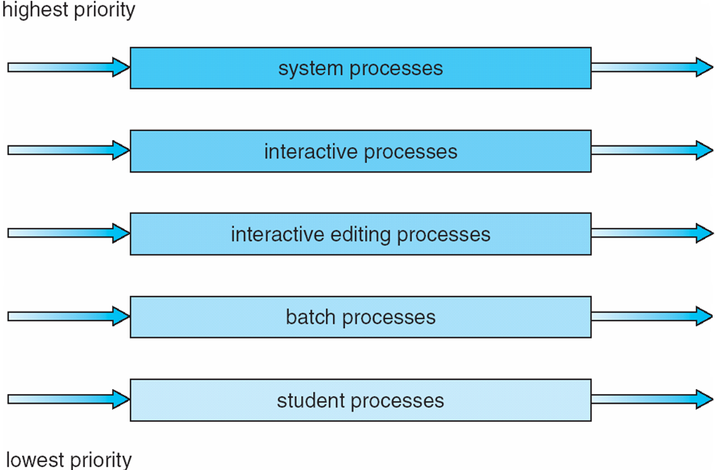
Multilevel Queue Scheduling

Slide 21
Multilevel Feedback Queue
A process can move between the various queues; aging can be implemented this way
  Aging can be implemented this way: if a process uses too much CPU time, it will be moved to a lower-priority queue.
Multilevel-feedback-queue scheduler defined by the following parameters:
  number of queues
  scheduling algorithms for each queue
  method used to determine when to upgrade a process
  method used to determine when to demote a process
  method used to determine which queue a process will enter when that process needs service

Slide 22
Example of Multilevel Feedback Queue
Three queues:
  Q₀ – time quantum 8 milliseconds
  Q₁ – time quantum 16 milliseconds
  Q₂ – FCFS
Scheduling
  A new job enters queue Q₀ which is served FCFS. When it gains CPU, job receives 8 milliseconds. If it does not finish in 8 milliseconds, job is moved to queue Q₁.
  At Q₁ job is again served FCFS and receives 16 additional milliseconds. If it still does not complete, it is preempted and moved to queue Q₂.
  Priority scheduling is applied among Q₀, Q₁, and Q₂

Slide 23
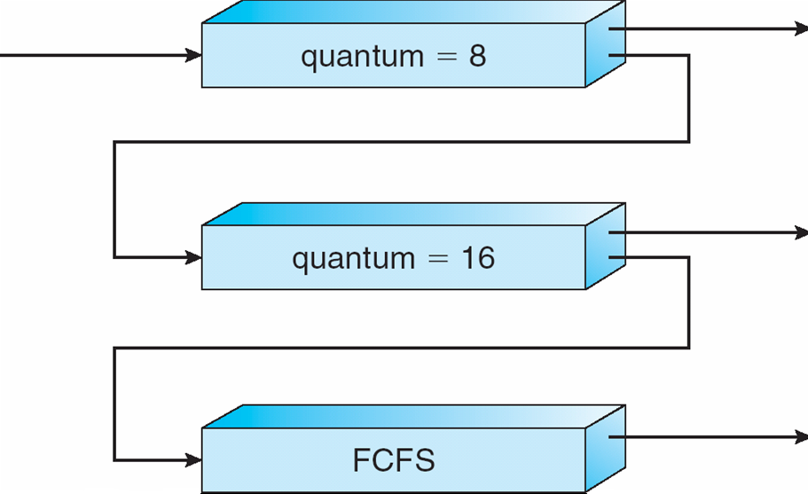
Multilevel Feedback Queues

Slide 24
End of Chapter 5

